Slide 2
Industrial design in international forums
Mary Critharis - Chief Policy Officer and Director for International Affairs February 9, 2021

Slide 3
Overview
International strategic objectives
International fora
Standing Committee on the Law of Trademarks, Industrial Designs and Geographical Indications (SCT).
Hague Working Group.
Bilateral and multilateral agreements/initiatives
ID5
Role of stakeholders
Conclusion

Slide 4
International strategic objectives
Develop and improve industrial design protection around the world through interactions and engagement at international forums.
Enter into cooperative agreements with other IP offices to further efficiencies.
Provide industrial design expertise via bilateral engagements with foreign governments, and participate in negotiations with the United States Trade Representative (USTR) on IP aspects of trade issues.

Slide 5
International strategic objectives
Engage internationally to help develop and improve industrial design protection systems, including through:
Engagement with international organizations to promote and improve design practices;
Provision of technical assistance and capacity-building programs; and
Participation in trade discussions related to designs.

Slide 6
International strategic objectives
Develop and improve industrial design protections around the world through engagements at international forums
World Intellectual Property Organization (WIPO)
Harmonization and technical support through the Standing Committee on the Law of Trademarks, Industrial Designs and Geographical Indications, the Hague Working Group, etc.
Development, negotiation, and implementation of the Design Law Treaty and the Hague Agreement Concerning Industrial Designs
World Trade Organization (WTO)
Monitoring developments and ensuring compliance with international IP standards through the TRIPS Council, WTO Accessions, and Trade Policy Reviews
Asian Pacific Economic Cooperation (APEC)
Providing guidance and training to governments in the Asia Pacific region on protecting and enforcing industrial design rights
Organization for Economic Cooperation & Development (OECD)
Evaluate the IP laws of aspiring OECD nations regarding implementation of the minimum IP requirements of the OECD community

Slide 7
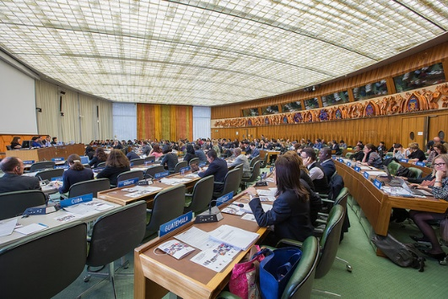
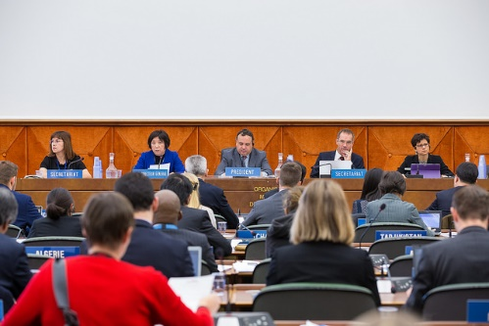
WIPO SCT
Graphical User Interface (GUI), icons, typefont
Longterm efforts led by the USPTO and JPO to identify the scope and availability of design protections for GUIs, icons, and typefonts around the globe.
Particular focus on:
requirements for a link between design and article; and
the methods allowed by offices for representing animated designs.
Building off data collected throughout 2017-2019, the USPTO and JPO are working together to promote the development of recommended practices for protecting GUIs.

Slide 8
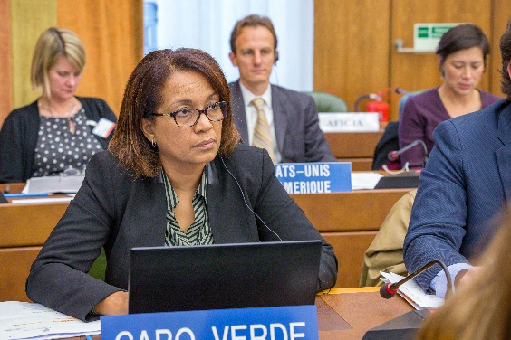
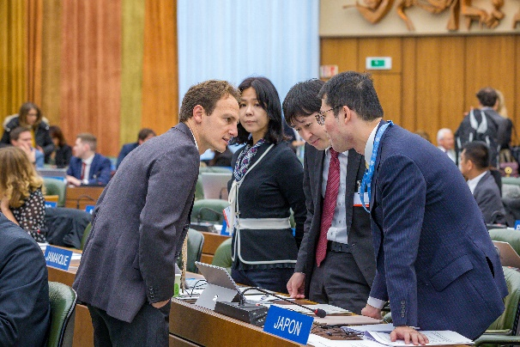
Hague Working Group
Hague Working Group on the Legal Developments of the Hague System for the International Registration of Industrial Designs
Modernization of the Hague System
Amendments to common regulations
i.e., extension of standard publication time
Updates to administrative instructions
Recent meeting:
9th Session (virtual) – December 14 to 16, 2020

Slide 9
International strategic objectives
Establish cooperation agreements/initiatives with other IP offices
The USPTO leads efforts to develop collaborative projects and best practices
ID5
USPTO launched initiative for the world’s largest industrial design offices (Europe, China, Japan, South Korea, and the United States) to develop industrial design policy and identify best practices and procedures for design applications.
The ID5 Partner Offices together handle about 90% of the world’s industrial design applications
Group B+
USPTO led initiative to pursue harmonization efforts among like minded offices including the USPTO, the contracting states to the EPC, the IP offices Canada, Australia, New Zealand, Japan, Korea, Singapore, and China, the EC, and the EPO.
Bilateral Engagements
Memorandum of Cooperation with the JPO.
Ongoing communications, trainings, initiatives with partners, including in the UK, EU, Egypt, and Mexico.

Slide 10
ID5
2015
2016
2017
2018
2019
2020
CNIPA Beijing, China
EUIPO Alicante, Spain
KIPO Seoul, Korea
JPO Tokyo, Japan
ID5 Launch at USPTO Alexandria, VA
ID5 Virtual Launch hosted by the USPTO

Slide 11
ID5
Studies and analysis of design protections related to grace period, partial designs, and new and emerging technologies
Since 2015, 4 of 5 partner offices have adopted a 12 month grace period for designs.
4 of 5 partners provide protections for less than the whole product, and practices are continuing to evolve.
All 5 partners provide protections in digital environments, and practices are changing.
Divergences in interpretations of the underlying article of manufacture.
Divergences in file formats.
All five offices implemented WIPO DAS.
ID5 joint recommendation on design formality practices.

Slide 12
Role of stakeholders
How to get involved:
WIPO
Observer status
User sessions
Continue direct communications with USPTO headquarters on relevant WIPO design issues
Continue to identify and raise issues through stakeholder meetings such as AIPLA, IPO, ABA, design specific conferences and forums
Collaborate with international stakeholder groups

Slide 13
Role of stakeholders
How to get involved:
ID5
Participate in user sessions held on the margins of the annual meeting.
Continue direct communications with USPTO headquarters on relevant WIPO issues.
Continue to identify and raise issues through stakeholder meetings and at design-specific conferences and forums.
Collaborate with international stakeholder groups.

Slide 14
Conclusion
International efforts help advance important industrial design objectives.
Strategic and coordinated efforts are being undertaken to address stakeholder concerns around the globe.
Continued communication/collaboration with stakeholders help drive USPTO efforts.

