Slide 1
Trademarks financial management update
Sean Mildrew Deputy Chief Financial Officer

Slide 2
Agenda
FY 2022 financial position & status of the business
On the horizon
FY 2023 budget status
FY 2024 budget formulation

Slide 3
FY 2022 trademark funding - outlook
Total estimated end of year trademark operating reserve is $193M, which is above the minimum operating reserve level of $120M
Notes:
We still project that we will collection more than our appropriated level and that we will deposit both patent and trademark fee revenue in the PTFRF
We estimated that we will end the year with $193M in the TM OR, which is above the minimum level of $120M
Reference (talking points are from prior presentations)
The appropriation level is based on our FY 2022 appropriated amount. This appropriated level is the fee estimates that we projected in our FY 2022 PB, which was formulated about a year ago. So the appropriated level is $4.058B for the agency. Of that, $450M is in TM revenue
Since then we have revised our fee estimates. We currently expect to collect about $48M more this year than the initial estimate. $25.7M is on the TM revenue side. If we do collect fees in excess of our apportionment, those fees will be deposited into our Patent and Trademark Fee reserve fund. We would have to submit a reprogramming request to congress to request those fees.. Since the establishment of our PTFRF, we have had to go through this process a few times and have successfully received approval to transfer those fees in the PTFRF to our main appropriation account.
In addition to our fee revenue, the agency has authority to spending our operating reserve and other revenue, which includes recoveries, parking fees, reimbursements and expenditure refunds. In total this is estimated to be around $736M for the agency, $218M for TMs
In total, the agency has authority to spend about $4.795B, $668M on the TM side
Our estimated end of year spending is about $4.7B for the agency, $475M for TMs.
Based on this information, we think we will end the year with $208M in the TM OR reserve, which is well above our minimum level of $125M

Slide 4
FY 2022 status: revenue and spending
Notes:
The chart shows our spending and revenue collections for the year. Data is as of June 30. We shared this chart with you last quarter and its predominately the same status
The green line is our annual spend plan for the year; we project to spend $475M
The blue bars show commitment and obligations which were around $365M through June 30
and the red bar is TM revenue received which was just over $347M thru June 30
The solid bars show our actuals revenue and spending while the patterned bars show our estimated revenues and spending for the remaining months of the year
By the end of the year, aggregate revenues and spending will be pretty close – revenue is projected at $475.9M and spending at $475.1M

Slide 5
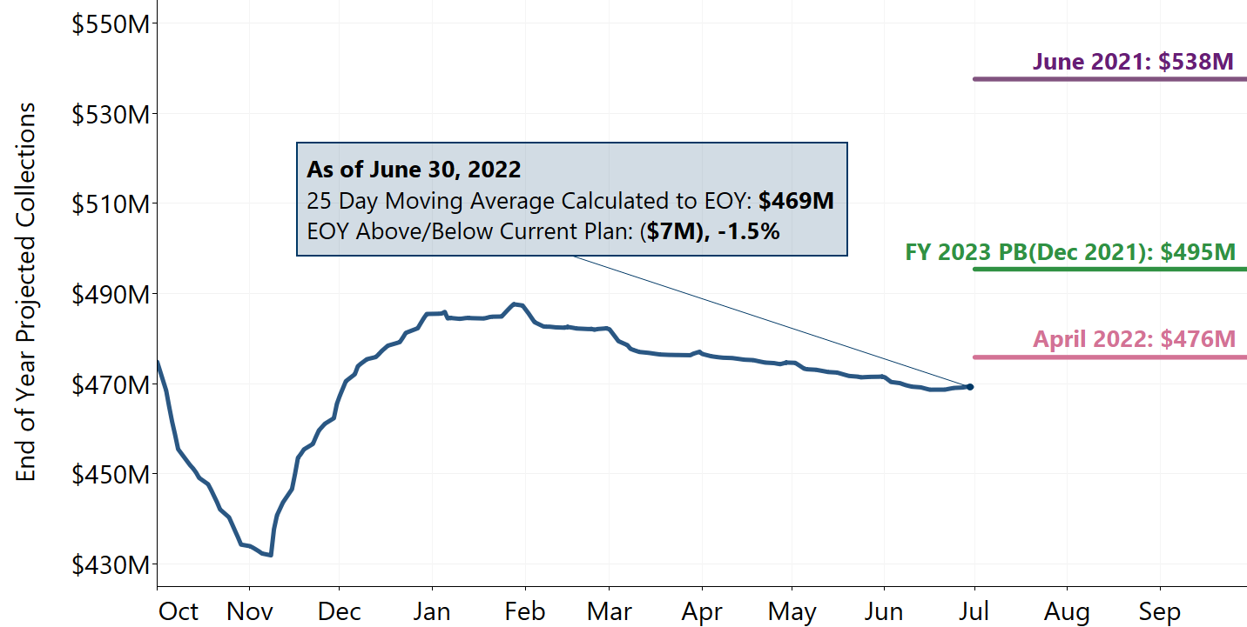
FY 2022 trademark revenue
Trademark revenue rate is $469M, trending below planning estimates

Slide 6
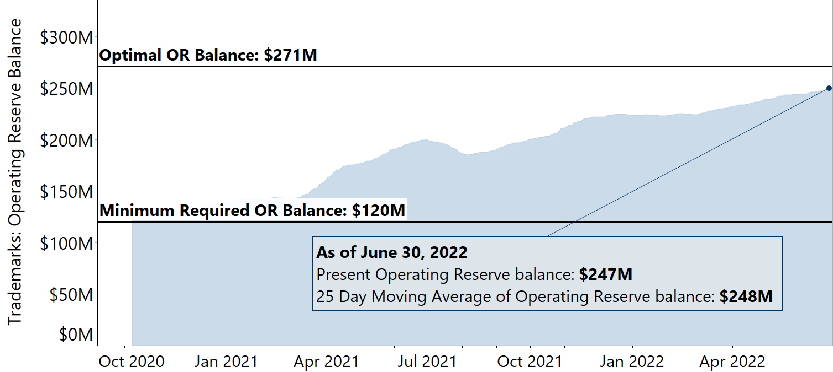
Trademark operating reserve Operating reserve balance is $247M, $127M above minimum levels

Slide 7
On the horizon
FY 2023 President’s budget
The Senate and House Commerce, Justice, Science, and Related Agencies (CJS) subcommittee appropriation hearings occurred on May 11, 2022 and May 12, 2022, respectively
Both hearings focused on other bureaus within the Department of Commerce (DOC)
FY 2024 Budget formulation
The USPTO is finalizing fee estimates and requirements for the FY 2024 OMB budget submission
We will provide the draft document to PACs and DOC for review in August 2022
The budget is tentatively scheduled to be submitted to Office of Management and Budget (OMB) on September 12, 2022

Slide 8
Thank you!
Sean Mildrew
Deputy Chief Financial Officer

